Slide 1
Cilk and Writing Code for Hardware
Jyothi Krishna V S
Nov 8, 2017

Slide 2
Cilk (Intel Cilk Plus)
Cilk C language for programming dynamic multithreaded applications on shared-memory multiprocessors.Cilk’s provably good runtime system automatically manages low-level aspects of parallel execution, including protocols, load balancing, and scheduling.
Why Cilk is a good starting point?
Cilk extends the C language with just a handful of keywords: cilk_spawn, cilk_sync, cilk_for
Cilk is processor-oblivious.
Cilk supports speculative parallelism.
Cool Supplymentary tools: CilkView and CilkScreen.

Slide 3
Fibonacci
A new thread created. The child Cilk procedure can execute in parallel with the parent caller.
int fib (int n) {
if (n<2) return (n);
else {
int x,y;
x = fib(n-1);
y = fib(n-2);
return (x+y);
}
}
int fib (int n) {
if (n<2) return (n);
else {
int x,y;
x = cilk_spawn fib(n-1);
y = cilk_spawn fib(n-2);
cilk_sync;
return (x+y);
}
}
Wait until all spawned children have returned.
C Code
Cilk Code

Slide 4
Consider n=4 ...
Continue Edge
Spawn Edge
Return Edge
int fib (int n) {
if (n<2) return (n);
else {
int x,y;
x = cilk_spawn fib(n-1);
y = cilk_spawn fib(n-2);
cilk_sync;
return (x+y);
}
}
Initial Thread
Exit
4
3
2
2
1
1
0
1
0

Slide 5
CilkView: A measure of Parallelism
Used for performance analysis of Cilk Program
Estimates Performance of your code for different number of processors
Gives the estimates of
Spawns
Maximum parallelism
Instructions executed etc

Slide 6
Work : 15,450 instructions
Span : 3,826 instructions
Burdened span : 263,826 instructions
Parallelism : 4.04
Burdened parallelism : 0.06
Number of spawns/syncs: 48
Average instructions / strand : 106
Strands along span : 12
Average instructions / strand on span : 318
Total number of atomic instructions : 54
Frame count : 102
Entries to parallel region : 2
Speedup Estimate
2 processors: 0.07 - 2.00
4 processors: 0.05 - 4.00
8 processors: 0.04 - 4.04
16 processors: 0.04 - 4.04
32 processors: 0.04 - 4.04
64 processors: 0.03 - 4.04
128 processors: 0.03 - 4.04
256 processors: 0.03 - 4.04
CilkView Output

Slide 7
ArraySum cilk_for
Spawns n threads
int main() {
int n = 100;
int total;
cilk_for(int i = 1; i <= n; ++i)
{
total += compute(i);
}
printf(“Total is %d”, total)
}
int compute(int i) {
return i;
}
Does this program give the correct answer, 5050?
Implicit cilk_sync
NOT Always !!
A potential race does not always happen at runtime and hence does not guarantee WRONG answer all the time 😓
Race on total.

Slide 8
Reduction
Defining Reduction operation with variable.
int main() {
int n = 100;
cilk::reducer_opadd<int> total;
cilk_for(int i = 1; i <= n; ++i)
{
total += compute(i);
}
printf(“Total is %d”, total)
}
int compute(int i) {
return i;
}
Reductions can be performed only for conductive operations like
Add
Xor
Max, Min etc.

Slide 9
Cilkscreen: Race Detection
Dynamic Race detection software.
Race detection is a VERY HARD problem.
CilkScreen does not guarantee 100% race free program.
~/cilk/bin/cilkscreen ./a.out
No errors found by Cilkscreen
Race condition on location 0x1aba310
write access at 0x401329: (~/test/matrix_multiply.cilk:51,__cilk_loop_d_002+0x51)
read access at 0x401325: (~/test/matrix_multiply.cilk:51, …..

Slide 10
Cilk Plus Resources
Home Page: https://www.cilkplus.org/
Runtime integrated with gcc 4.9 onwards. If you have gcc 4.9 and above just use -fcilkplus flag
CilkScreen: https://software.intel.com/en-us/articles/an-introduction-to-the-cilk-screen-race-detector
CilkView: https://www.cilkplus.org/tutorial-cilk-tools
Load Balancing, Work stealing.
Also look into Cacti stack : Cilk Memory Model

Slide 11
Writing Code for Hardware
Understanding and coding to the underlying hardware can improve your parallel performance
Amdahl's law
Speedup S =1/ ((1-p) + p/s )
Actual Speedup = 1/ ((1-p) + p/s + T(s) + S(s))
T(s) : Thread/ task creation cost
S(s): Synchronization cost
Correctness
Parallelism / Scalability
Reduction in Communication/ Synchronization
Load Balance among Threads
Other optimizations
Priority

Slide 12
Correctness
Subjective to requirement
x=1; y= 0;
Thread 1:
atomic(y = 1);
atomic(x = 1);
Thread 2:
if (x == 1) {
atomic(y = 0);
} ----------------------------
assert( x || y);
Thread 1:
x = 3;
y = 5;
Thread 2:
x = 1;
y = 4;
----------------------------
assert( x< y);
Racy but correct.
Race Free but can be incorrect.

Slide 13
Improve Performance
Choice of algorithm (the s factor in Amdahl’s law)
SSSP : Dijkstra, Bellman-Ford (Scalable)
Sequential Dijkstra performs very well.
But, Bellman-Ford is nicely parallelizable.
Avoid Branches, small kernels
High T(s), Moderate S(s)
Choice of Hardware: CUDA (GPU) / Cilk (CPU)
GPU: Scratch Memory, SIMD , larger no of threads
CPU: False Sharing, MIMD, Faster threads
Avoid False sharing
Moderate T(s), Moderate S(s)

Slide 14
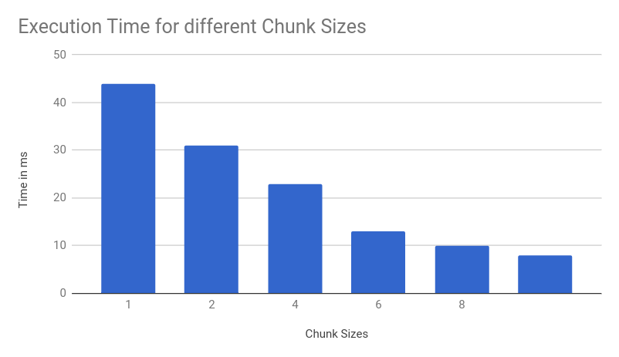
Example 1 : CPU False-sharing effect
Consider a cache line of 8 word
For N = 100,000, Intel core i7, 8 Threads
int a[];
Int i;
<parallel for>
for(i=0;i<N;i++) {
a [i] = i+2;
}

Slide 15
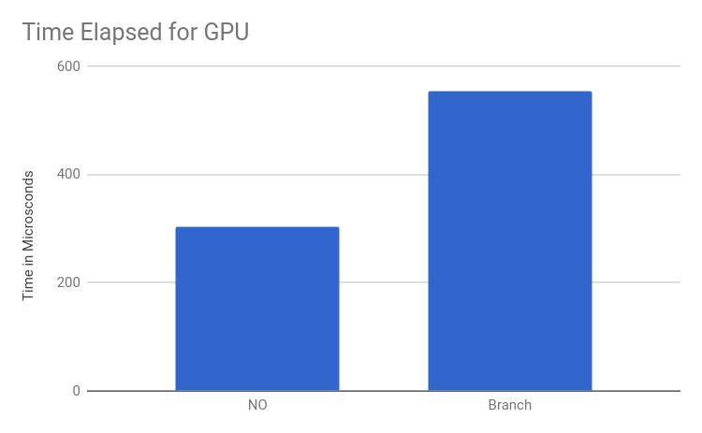
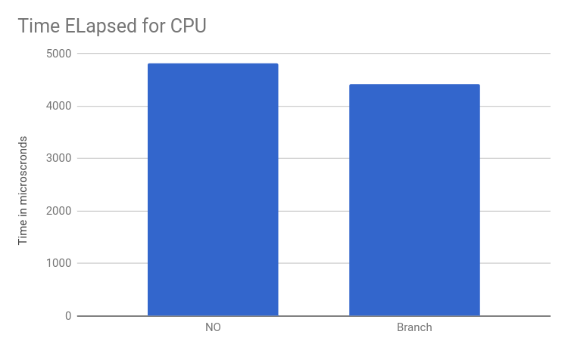
Example 2: Effect of Branches in GPU
Kernel Code:
Without branch:
void addk(int* dA, int* dB, int* dC) {
int id = blockIdx.x * blockDim.x + threadIdx.x;
dC[id] = dA[id] + dB[id];
}
With Branch:
void addk(int* dA, int* dB, int* dC) {
int id = blockIdx.x * blockDim.x + threadIdx.x;
if(id %2 == 0 )
dC[id] = dA[id] + dB[id];
else
dC[id] = dA[id] - dB[id];
}
N = 1200000
Does not contain copy cost.

