Slide 1
Subdivision Surface
MTCG - 2012
Amit Kumar Maurya
(CS11M003)

Slide 2
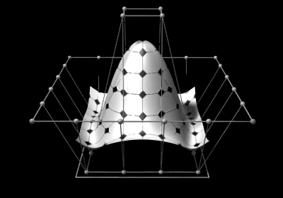
Spline surface (NURBS)
Used for constructing high quality surface and free form surfaces for editing task
Image of rectangular domain under parameterization f – produces a rectangular surface patch embedded in R
Complex structure require model to be decomposed into smaller tensor-product patches - Topological constraints
Smooth connection between patches – Geometric constraints

Slide 3
Goal - Subdivision Surface
To represent curved surface in the computer
Efficiency of Representation
Continuity
Affine Invariance
Efficiency of Rendering
How do they relate to splines/patches?
Why use subdivision rather than patches?

Slide 4
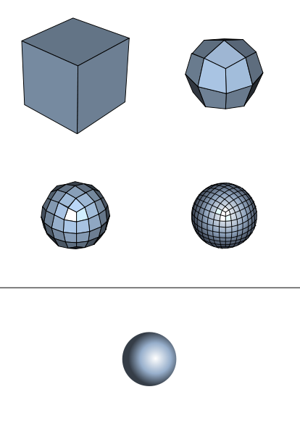
Subdivision Surface
Approach Limit Curve Surface through an Iterative Refinement Process.
Coarse control mesh
Surface of arbitrary topology can be represented
(Old and new) Vertices are adjusted based on set of local averaging rules

Slide 5
Subdivision scheme
Classification of subdivision scheme
Type of refinement rule – (face split or vertex split)
Type of generated mesh (triangular or quadrilateral)
Square
Triangular
Quadrilateral
(face split
vertex split

Slide 6
Mesh type
For regular mesh, it is natural to use faces that are identical
If faces are polygon, only three ways to choose face polygon
Squares
Equilateral triangles
Regular Hexagons

Slide 7
Types of Subdivision
Interpolating Schemes
Limit Surfaces/Curve will pass through original set of data points.
Approximating Schemes
Limit Surface will not necessarily pass through the original set of data points.
Face split
 | Triangular mesh | Quad. Meshes
Approximating | Loop(C²) | Catmull-Clark (C²)
Interpolating | Mod. Butterfly (C¹) | Kobbelt (C¹)
Vertex split
Doo-Sabin, Midedge (C¹) Biquartic (C²)

Slide 8
Subdivision Surface
Chaiken’s Algorithm in 2D
An approximating algorithm
Involves corner cutting
New control points are inserted at ¼ and ¾ between old vertices
Older points are deleted

Slide 9
Chaiken’s Algorithm in 2D
Q₃
P₂
Q₂
P₁
Q₄
Q₁
Q₅
Q₀
P₃
P₀
Q_{2i} = ¾ P_{i} + ¼ P_{i+1}
Applying iteratively
Q_{2i+1} = ¼ P_{i} + ¾ P_{i+1}
After each iteration , number of points generated is twice the number of edges present in each previous diagram
Border (Terminal points) are special cases
The limit curve is a quadratic B-spline!

Slide 10
Chaikin algorithm in Vector Notation
0
0
0
0
0
0
3
1
0
0
0
0
1
3
3
1
0
0
0
0
1
3
3
1
0
0
0
0
1
3
0
0
0
0
0
0
P^{k+1}_{2i-2}
P^{k}_{i-2}
P^{k+1}_{2i-1}
P^{k}_{i-1}
P^{k+1}_{2i}
1/4
P^{k}_{i}
P^{k+1}_{2i+1}
P^{k}_{i+1}
P^{k+1}_{2i+2}
P^{k}_{i+2}

Slide 11
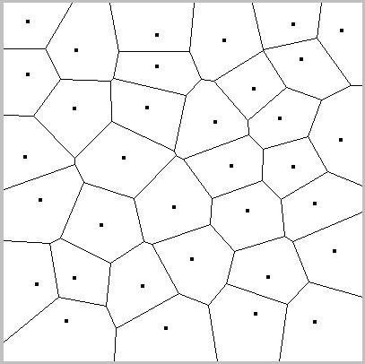
Voronoi Diagrams
Decomposes the metric space based on distance
Let P = {P₁,…..P_{n}} be a set of points (sites) in R. For each site Pi, its associated Voronoi region V(pi) is defined as follows
$$V\left(p_{i}\right)=\{x ∈R^{d}:\left|\left|x −p_{i}\right|\right|≤\left|\left|x −p_{j}\right|\right|, j ≠i$$

Slide 12
Voronoi Diagrams
Voronoi Diagram construction
Fortunes-algorithm
Sweep line - For each point left of the sweep line, one can define a parabola of points equidistant from that point and from the sweep line
Beach line - The beach line is the boundary of the union of these parabolas
Source - Wikipedia

Slide 13
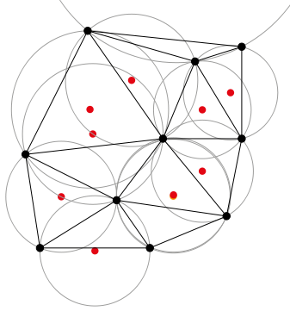
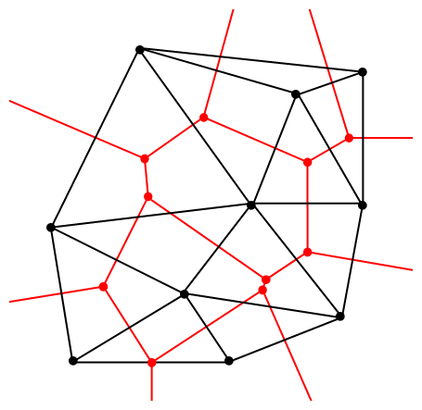
Delaunay triangulation
Dual structure for Voronoi diagram; each Delaunay vertex p is dual to its Voronoi face V(p)
Covers the convex hull of point set P

